Slide 1
Description
Description
This project uses an e-commerce dataset from Kaggle. The dataset includes transactional data from Amazon, providing detailed insights into sales trends, product performance, and fulfilment processes.
Steps ->
import csv file from dataset
Clean and Transform using pandas
Save cleaned data into csv file
Import csv file into mysql workbench
Write sql queries to perform further analysis
Generate Power BI visualisation

Slide 2
Phase : 1 Data Exploration and Quality Check
Facts and assumption about data set
1. Order_id is used as primary key
2. Schema – Datatypes have been checked
3. There are nulls or missing values for Amount, Courier Status, promotion-ids, fulfilled-by, Unnamed: 22
4. Some columns are not required that can be dropped - 'Unnamed: 22', 'fulfilled-by', 'ship-country', 'currency’
5. Some columns are replaced with NaN if null - ['ship_city', 'ship_state', 'ship_postal_code', 'promotion_ids’]
6. Date formats are different that need to be reformatted

Slide 3
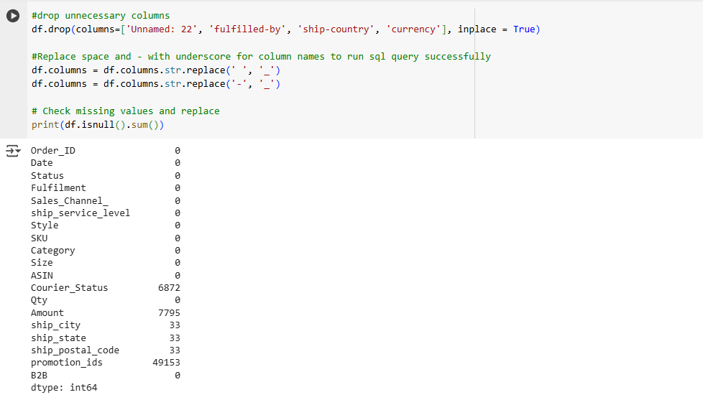
Phase 2: Data Cleaning and Transformation

Slide 4
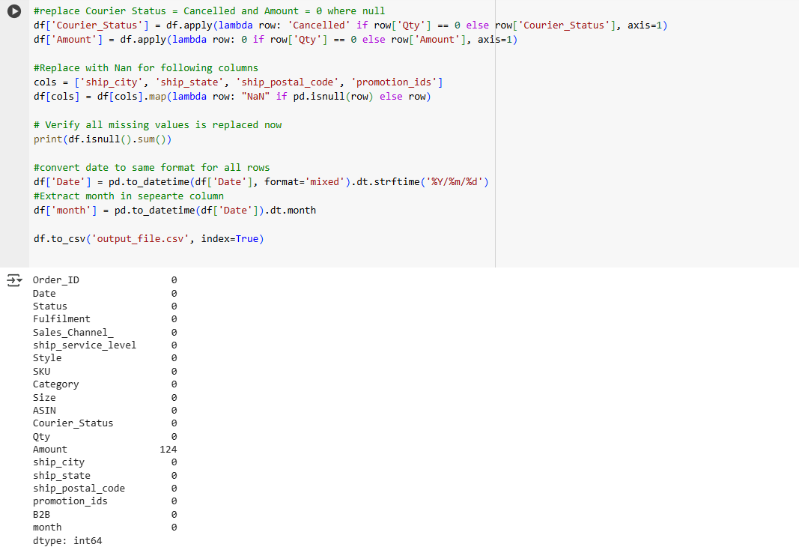

Slide 5
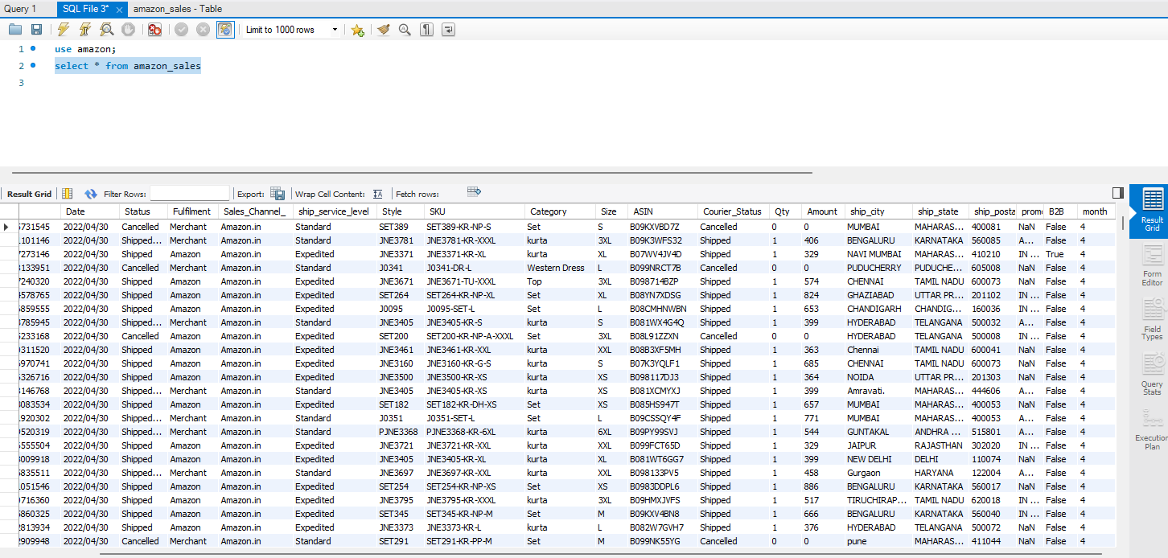
Cleaned Data set
Date is formatted across whole dataset
Month column is extracted
Amount is filled with Zero where it was null and status is cancelled
Unnecessary column are dropped

Slide 6
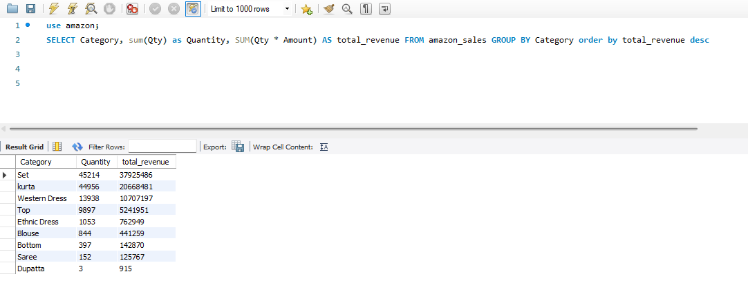
Phase 3: Business Questions and Insights
Category Performance :
Which product categories generate the highest revenue and quantity sold?
Are there any low-performing categories that need attention?
SQL Query and output

Slide 7
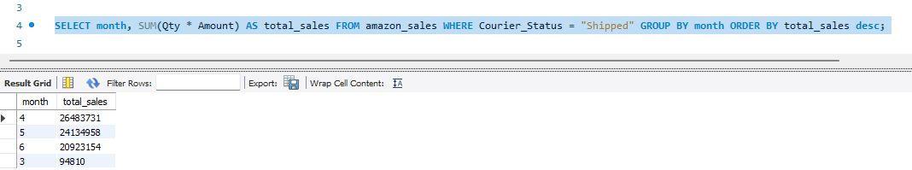
#Seasonal Sales Trends: What are the monthly sales trends?
SQL Query and output
# 4th month highest sales

Slide 8
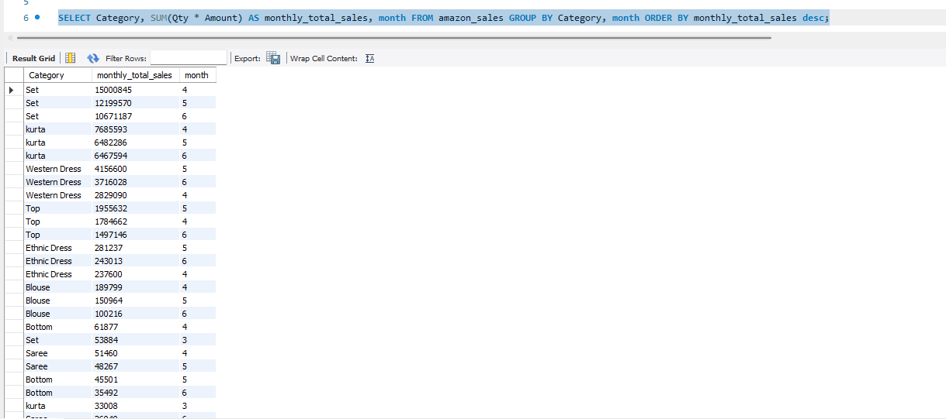
# Set is most selling product in 4th month

Slide 9
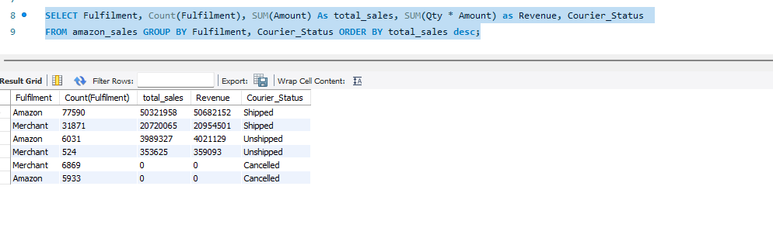
Fulfilment Efficiency:
how do sales and revenue differ across fulfilment methods (Amazon Fulfilled vs. Seller Fulfilled)?
- Amazon has more revenue

Slide 10
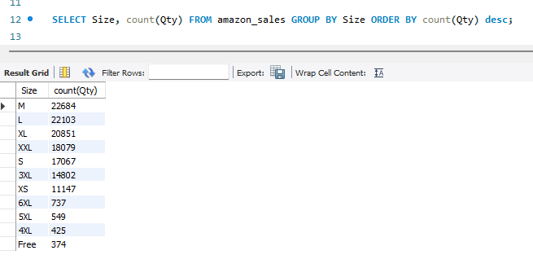
4. Product Size Analysis:
# which sizes are most popular in terms of quantity sold? - Medium
'SELECT Size, count(Qty) FROM amazon_sales GROUP BY Size ORDER BY count(Qty) desc'

Slide 11
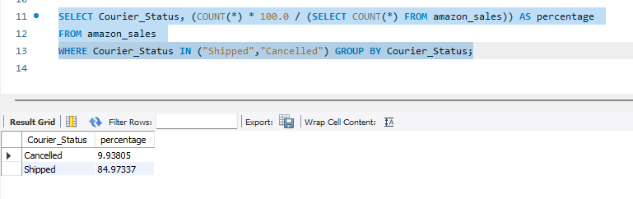
5 Courier Impact on Revenue:
# What is the percentage of lost or delayed shipments? (we don't have lost, delayed in the data set so used "Shipped","Cancelled")
SELECT Courier_Status, (COUNT(*) * 100.0 / (SELECT COUNT(*) FROM amazon_sales)) AS percentage FROM amazon_sales WHERE Courier_Status IN ("Shipped","Cancelled") GROUP BY Courier_Status;

Slide 12
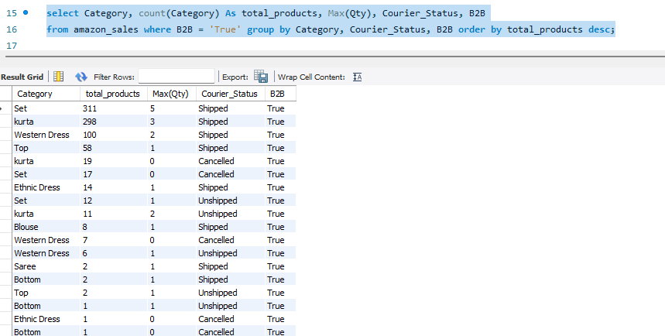
6 Are there any specific categories or styles that perform better in B2B sales?
Set is sold more than other in B2B sale
select Category, count(Category) As total_products, Max(Qty), Courier_Status, B2Bfrom amazon_sales where B2B = 'True' group by Category, Courier_Status, B2B order by total_products desc;

Slide 13
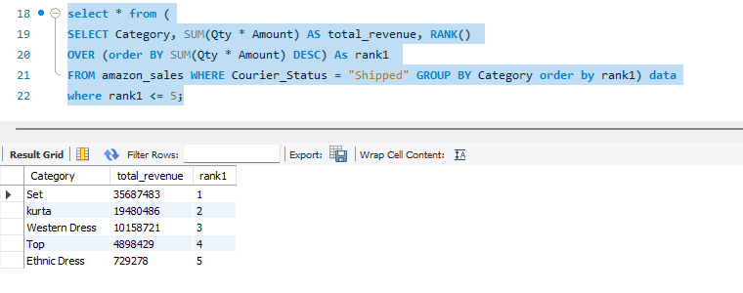
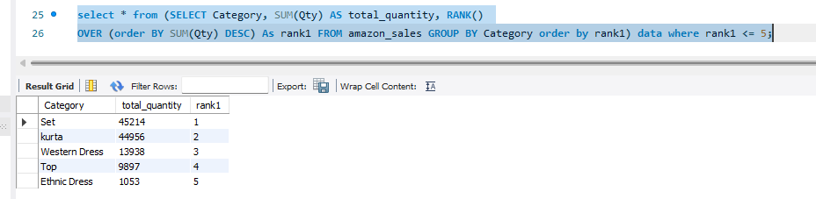
Phase 4: Advanced Reporting and Visualization
Top 5 products by revenue.
select * from (SELECT Category, SUM(Qty * Amount) AS total_revenue, RANK() OVER (order BY SUM(Qty * Amount) DESC) As rank1 FROM amazon_sales WHERE Courier_Status = "Shipped" GROUP BY Category order by rank1) datawhere rank1 <= 5;
Top 5 products by quantity sold.
select * from (SELECT Category, SUM(Qty) AS total_quantity, RANK() OVER (order BY SUM(Qty) DESC) As rank1 FROM amazon_sales GROUP BY Category order by rank1) data where rank1 <= 5;

Slide 14
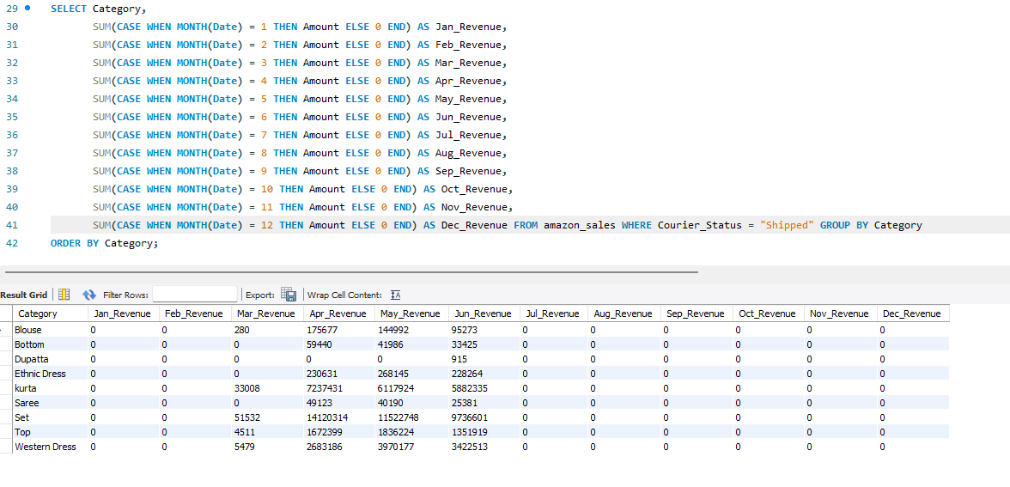
Phase 4: Advanced Reporting and Visualization
Create a pivot table to show monthly revenue for each category.

Slide 15
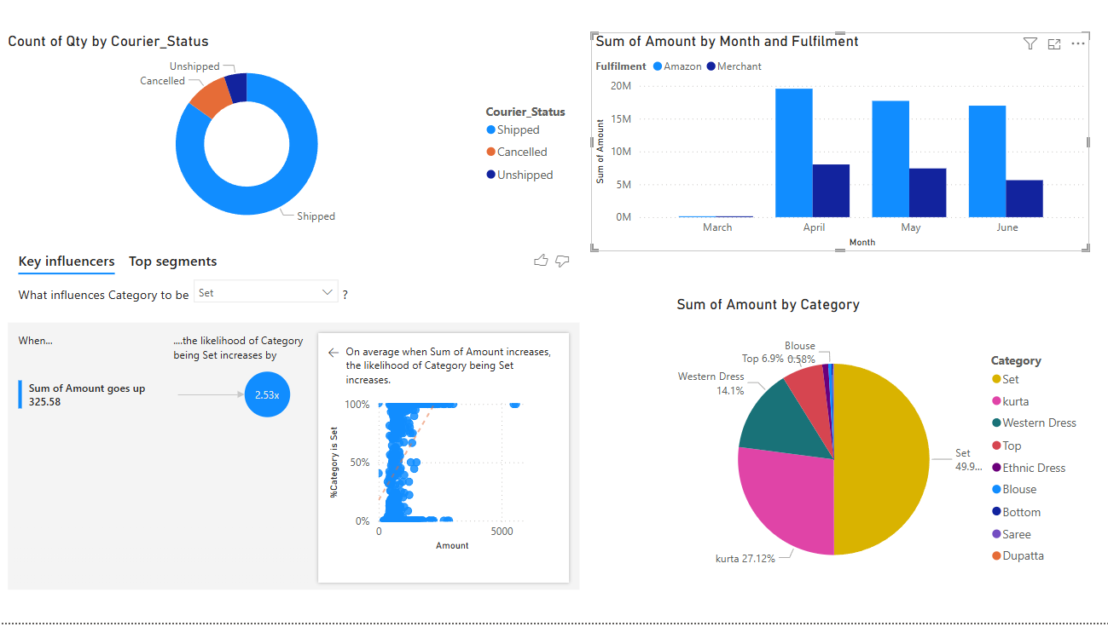
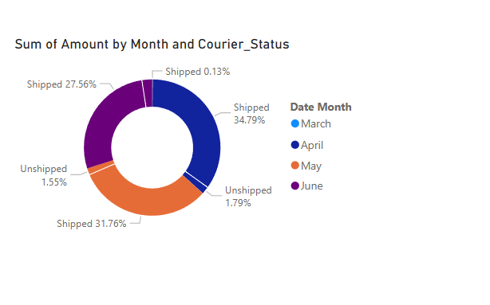
BI Report

